Slide 1


Slide 2
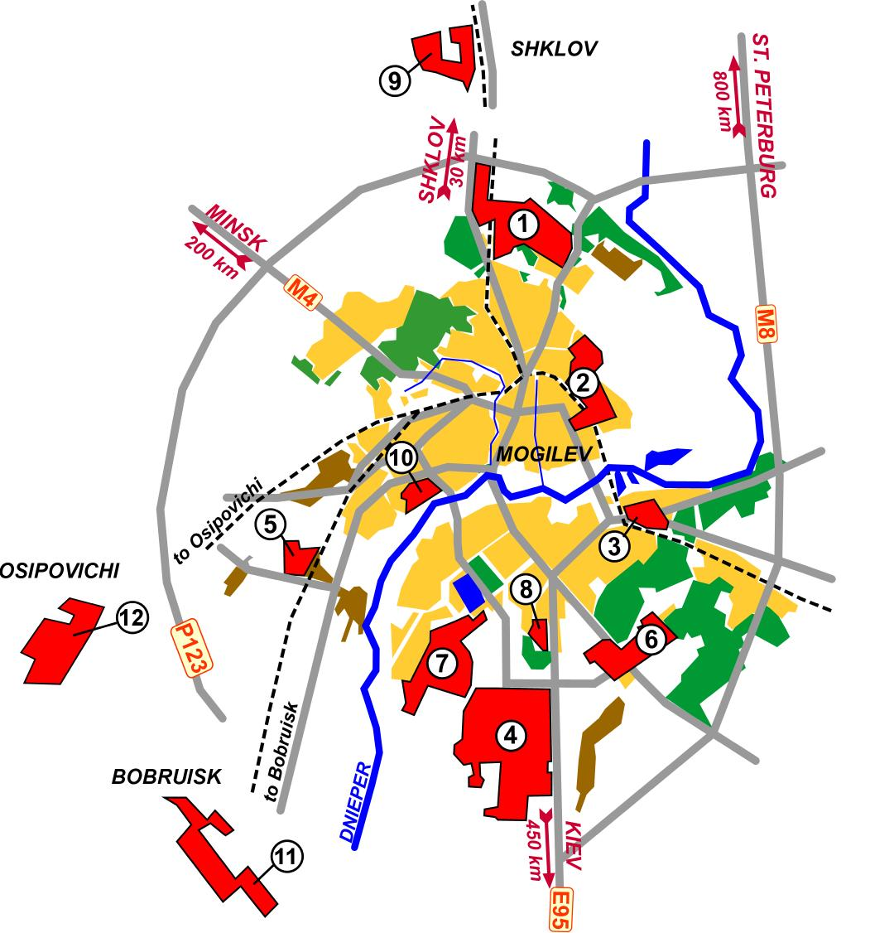
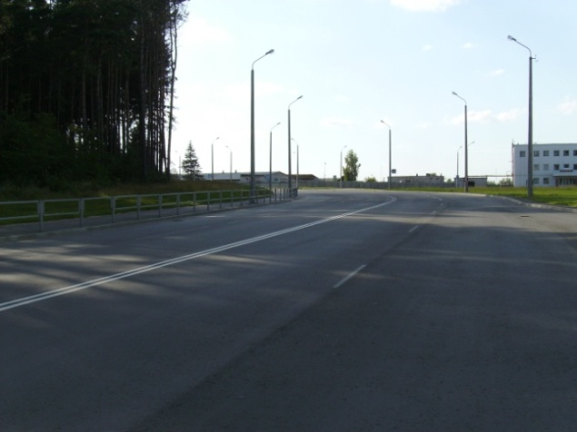
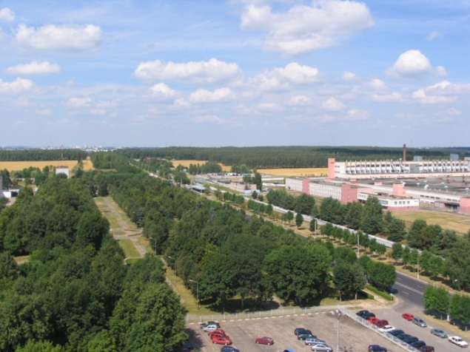
Mogilev FEZ structure
The territory of Mogilev FEZ consists of 12
sites
Total area of Mogilev FEZ 2 840.7 ha
Vacant land lots 390,5 ha
Vacant production premises 140 000 sq. m.
All sites are located in industrial hubs
Site 1 – 373 ha
Site 2 – 182.6 ha
Site 3 – 65.69 ha
Site 4 – 925.23 ha
Site 5 – 78.5 ha
Site 6 – 187.95 ha
Site 7 – 237.03 ha
Site 8 – 58 ha
Site 9 – 92.14 ha
Site 10 – 99.23 ha
Site 11 – 293.92 ha
Site 12 – 248.12 ha

Slide 3

Mogilev FEZ today
43 residents
Total investments = more than EURO 1.1 bln.
34 enterprises has already launched production
5 enterprises started production in 2014
5 enterprises will start production in 2015
Production output in 2014 is about USD 1,7 bln.
Exports to 105 countries

Slide 4
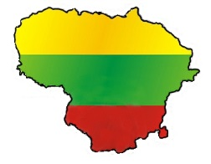

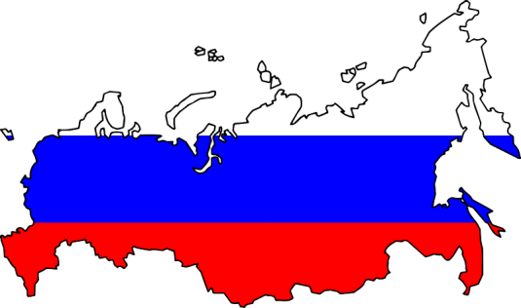
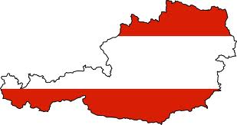
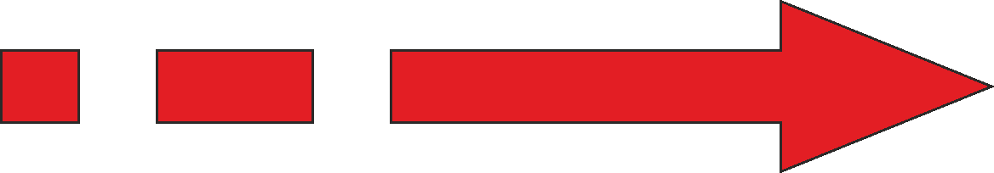


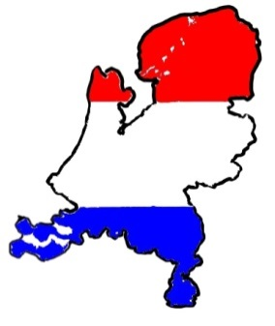

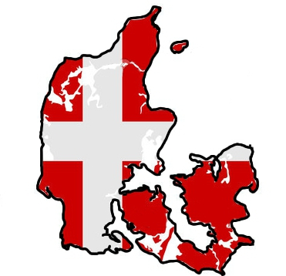

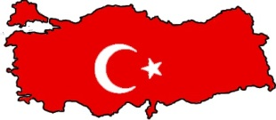
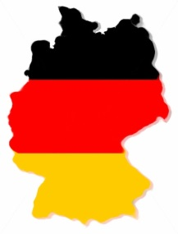
Origin of foreign investments
Finland
Russia
Austria
Lithuania
Israel
Netherlands
Denmark
Cyprus
Turkey
Germany

Slide 5
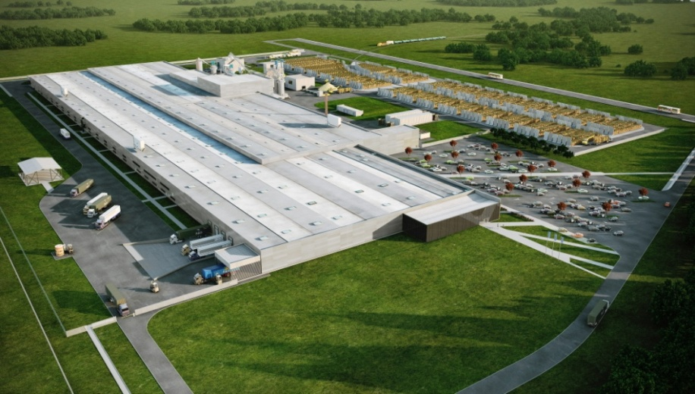


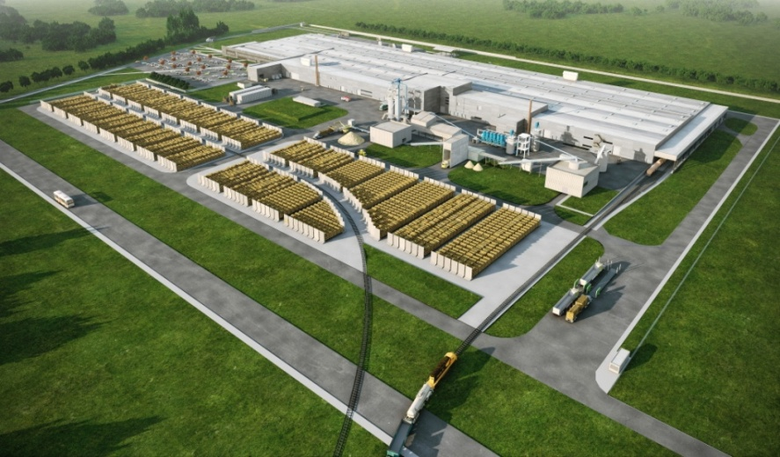
VMG Industry, Foreign Limited Liability Company
Project:
Vertically integrated wood-processing complex
Investor:
  - Lithuania
  - Netherland
Employees: 1200

Slide 6
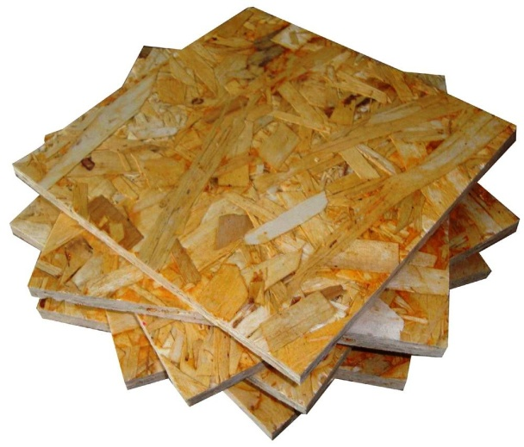
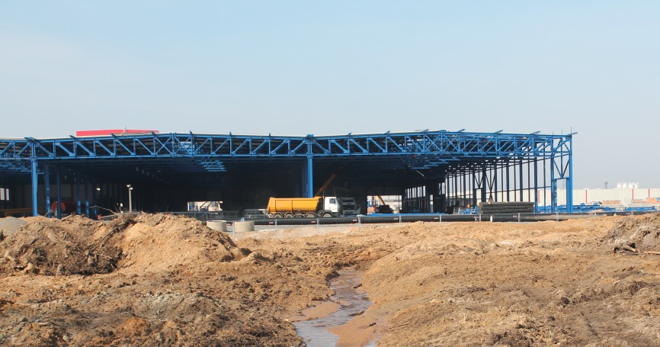

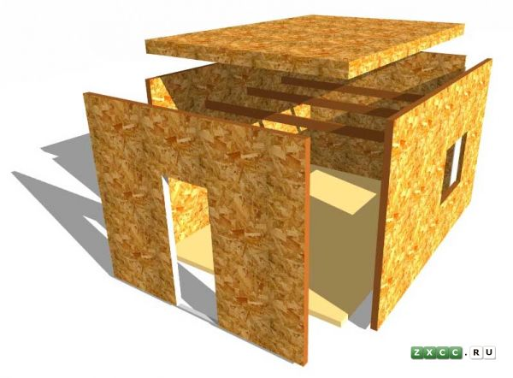
Kronospan OSB, Foreign Limited Liability Company
Project:
Setting up production of materials for furniture and construction industries
Investor:
  - Austria
Employees: 125

Slide 7
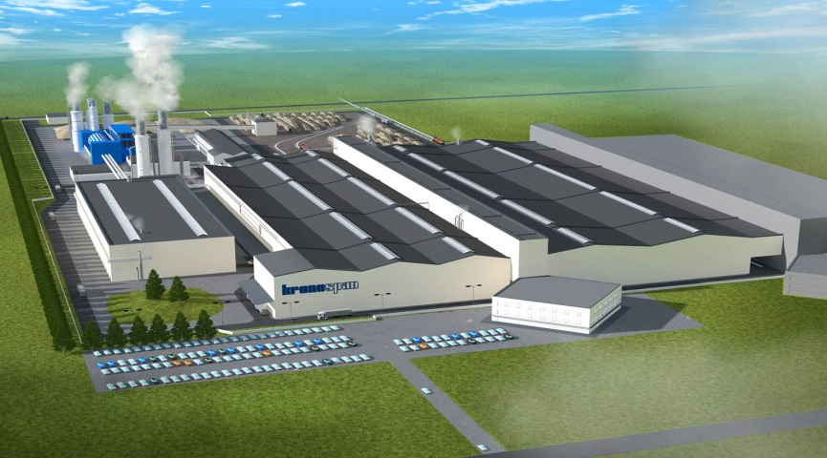

Kronochem, Foreign Limited Liability Company
Project:
«Setting up the production of the urea-formaldehyde resins and the phenol formaldehyde resins»
Investor:
  - Austira
Employees: 25

Slide 8
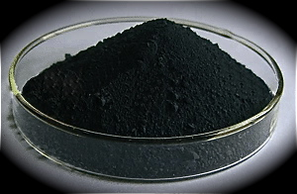
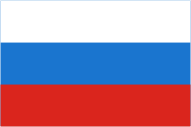

Omsk Carbon Mogilev, Foreign Limited Liability Company
Project :
Setting up an enterprise for carbon black production
Investor :
  - Russia
Employees : 448

Slide 9
Performance indicators of Mogilev FEZ
Share of Mogilev FEZ in the Mogilev region, %
Production output
Export
Investments in fixed assets
FDI on a net basis
Share of Mogilev FEZ in the Republic of Belarus, %
Production output
Export
Investments in fixed assets
FDI on a net basis

Slide 10
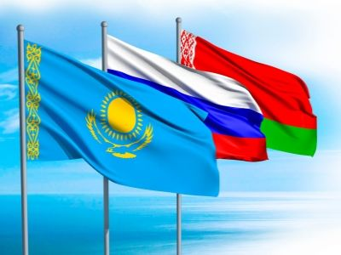

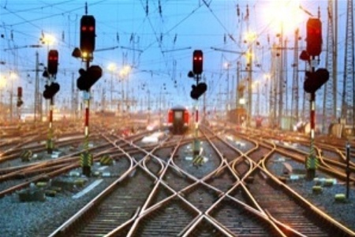
Advantages of Mogilev FEZ
Preferences for residents:
Customs preferences
Tax preferences
Common economic space in frame of
Eurasian Economic Union
Preferences in allocation of the land lots
Exemption from obligatory currency exchange
Highly developed logistics
Qualified staff
Highly developed engineering and transport
infrastructure
State sponsorship of the infrastructure development

Slide 11

Terms of investing and registration of Mogilev FEZ residents
Requirements to investment projects:
Investments >= EUR 1 mln.
It takes ≤ 14 workdays for state registration and registration as a resident of Mogilev FEZ (if a business plan is ready)
1 day
Investor`s proposal
Depends on investor
Business plan development
14 days
Business plan expertise and registration as a resident of Mogilev FEZ
State registration

Slide 12
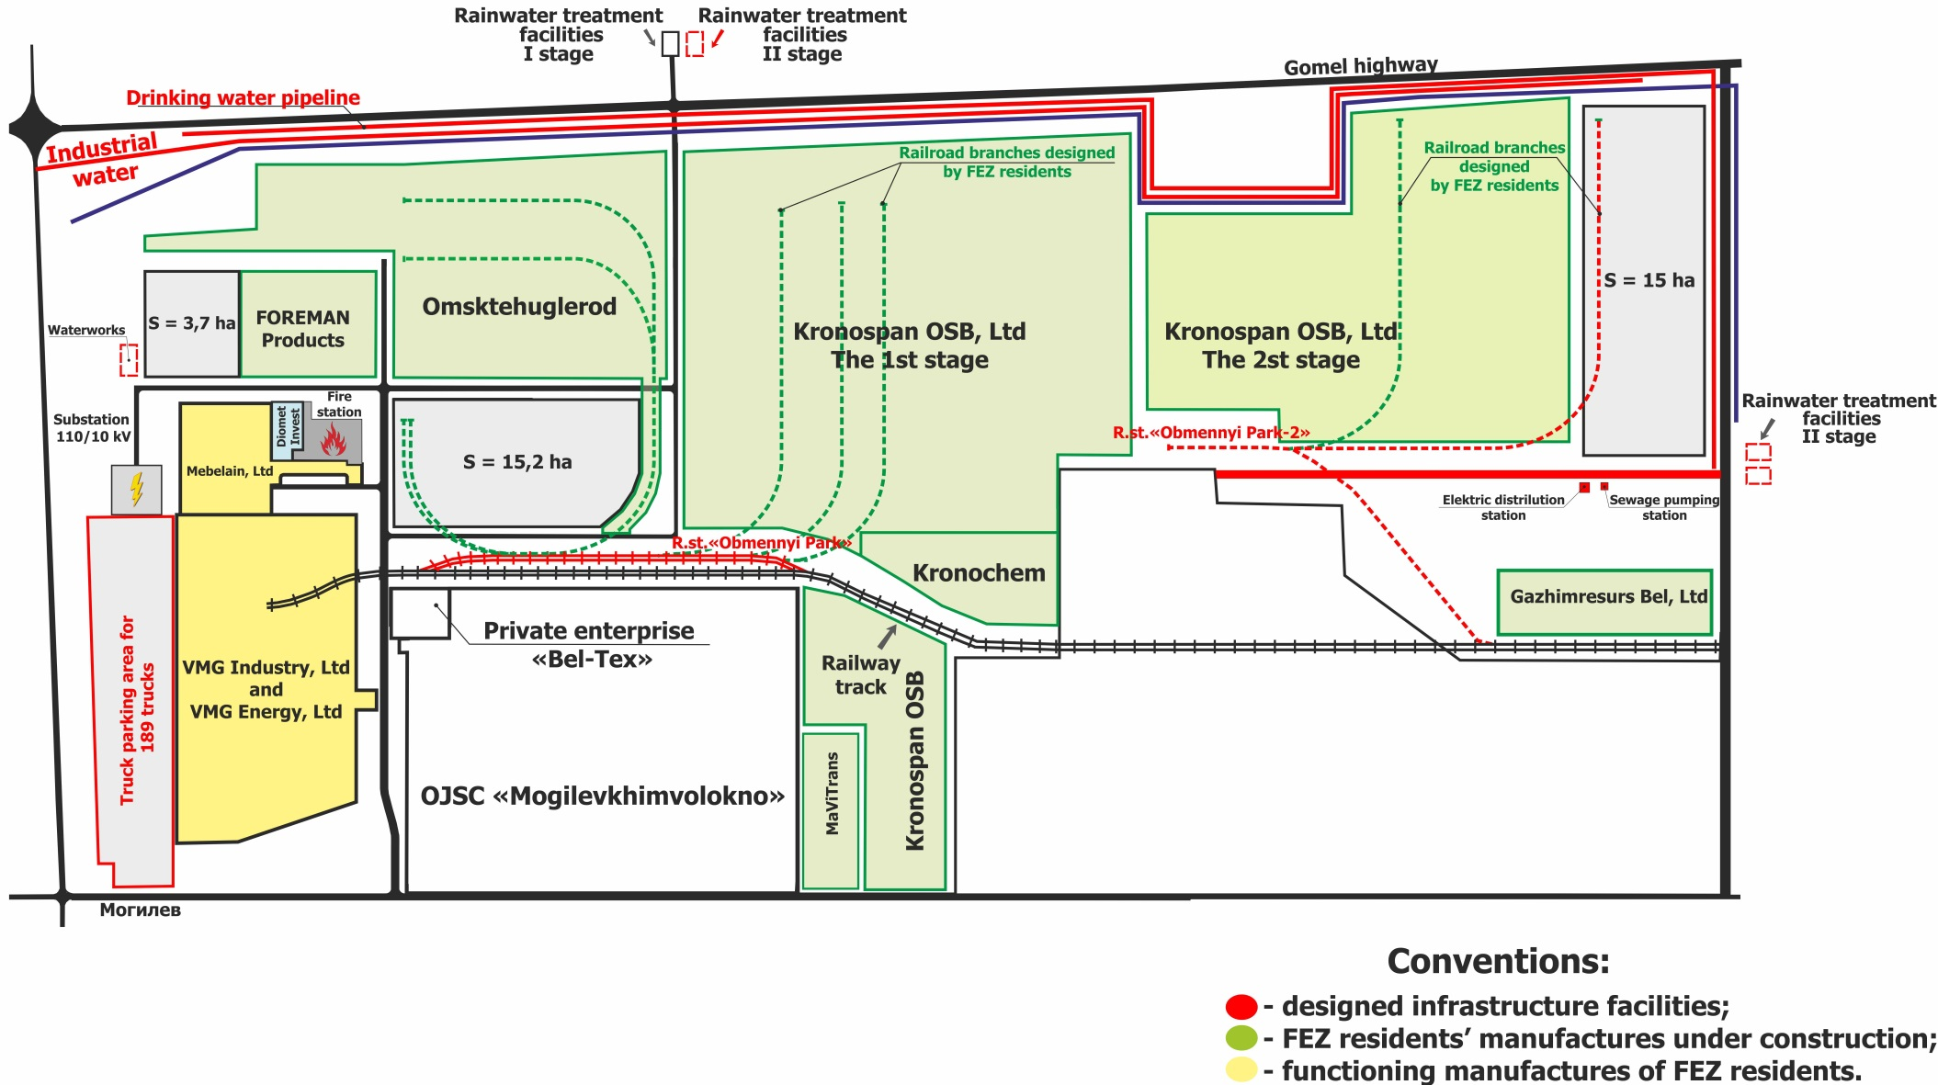
Site№ 4 of Mogilev FEZ
The first stage of infrastructure construction was finished during 2012-2013 years. About 16 million dollars US was invested into the first stage. Realizing the second stage of the construction involves investments of 20 million dollars US.

Slide 13
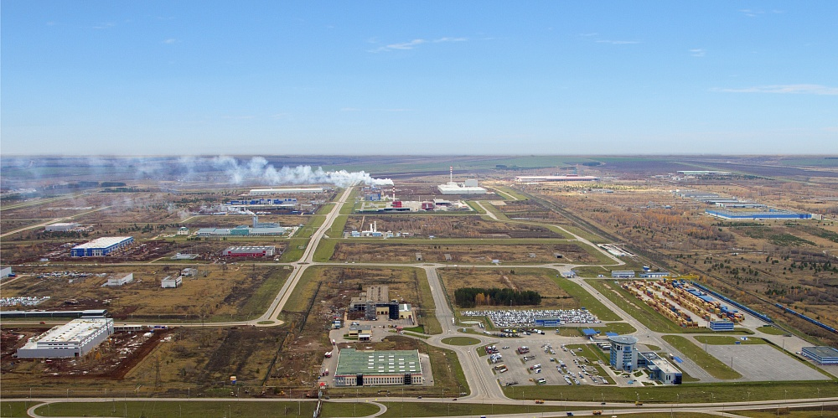
Mogilev FEZ – new perspectives
Establishment the cluster
of auto components’ manufacturers

Slide 14
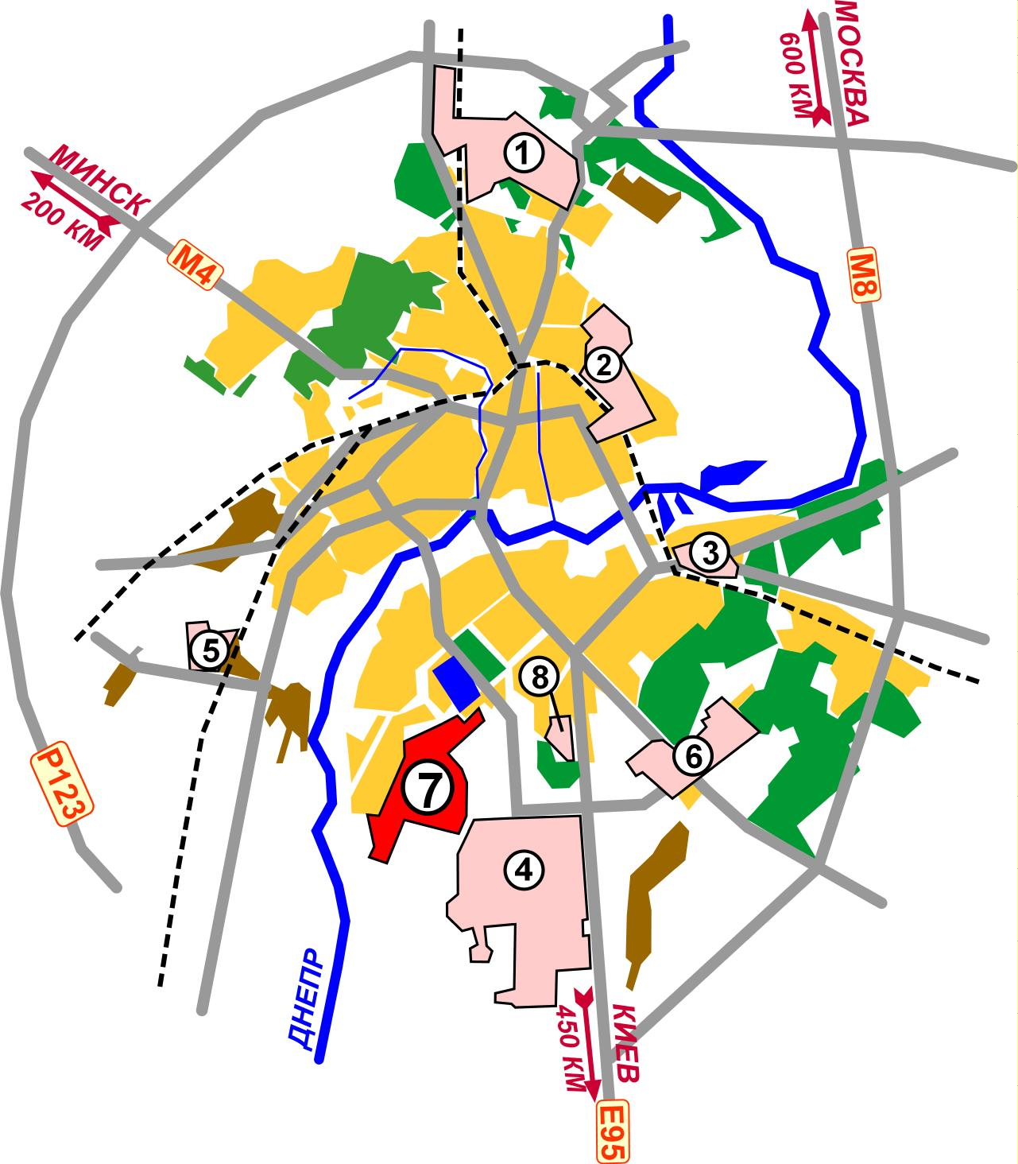
Location and advantages
Site № 7 (total area - 237,9 ha)
Locate on the border of Mogilev
Water-supply
Gas pipeline of high and low
pressure
Sewer-system
Electric power supply
Access roads

Slide 15
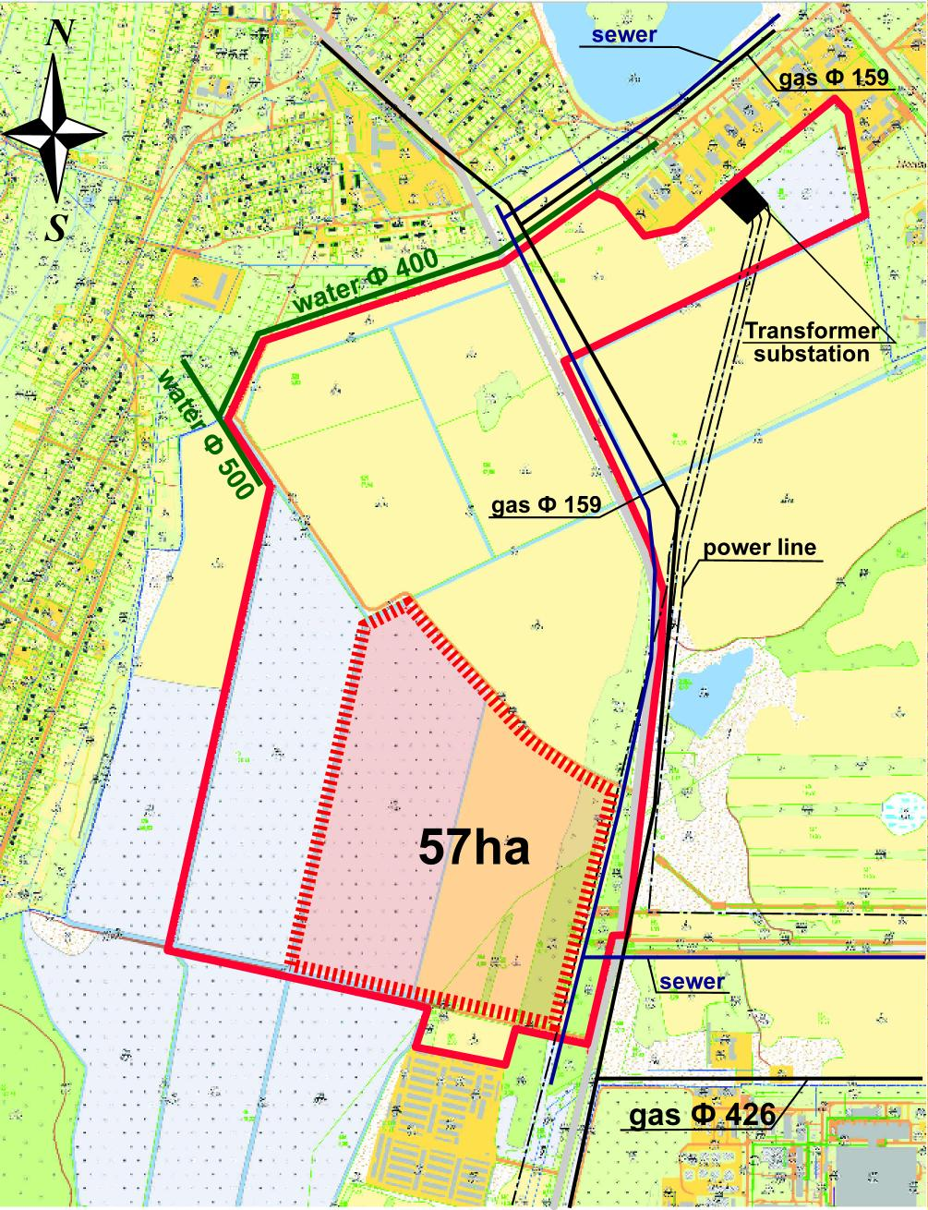
The Project Area
Mogilev FEZ, Site No. 7
1st stage of construction: 57 ha
At the city limits of Mogilev
1.5 km away from the international highway
St. Petersburg – Odessa
In close vicinity to the major streets of Mogilev (public transport routes)
Even area without significant level differences
Major utility networks are available

Slide 16
WWW.FEZMOGILEV.BY
Whenever you see a successful business, someone once made a courageous decision.
Peter Ferdinand Drucker

