Slide 1

2nd European Games 2019
Minsk, Belarus

Slide 2




4000
50
European countries
23
Events
Athletes
15
Sports
More than
8000
10
Qualification events to Tokyo 2020
official participants
5
Official European
Championships
More than
200
22
23
24
25
26
26
27
28
21
30
Medal events
95
92
21
Opening
ceremony
June 2019
Closing
ceremony
Men’s
Women’s
Mixed

Slide 3



Sport – Tokyo 2020 Qualifications
10 Sports are the Part of the 2020 Summer Olympics Qualification System:
Archery
Athletics
Badminton
Boxing
Canoe Sprint
Cycling
Judo
Karate
Shooting
Table Tennis

Slide 4

TV Broadcast
International Sports Broadcasting company (ISB) is nominated as a host broadcaster of the 2nd European Games 2019;
ISB was involved in TV production of the Olympic Games, World and European Championships and other major sport events of the world;
TV signal will be delivered to 160 countries;
The owner of the TV production rights at the territory of the Republic of Belarus is a channel “Belarus TVR” (tvr.by) (Belteleradiocompany), that will provide a live broadcast of a maximum number of sport disciplines on 4 TV channels.
600 hours of video content will be produced during the European Games.
Special editions, daily TV magazines and press conferences are also included in the video content package.

Slide 5

Venues

Slide 6
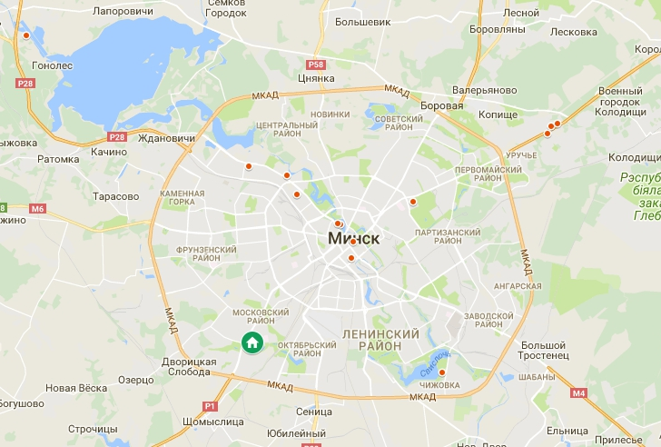



















All Competition Venues
15
CHIZHOVKA Arena
DINAMO Stadium
Falcon Club
Minsk Arena
Velodrome (Minsk Arena)
Minsk City Centre (Cycling – Road)
Olympic Sports Complex (Archery)
Olympic Sports Complex (Beach Soccer)
Palova Arena
Sports Palace
Shooting Centre
Sporting Club
URUCHIE Sports Palace
Olympic Tennis Centre
ZASLAVL Regatta Course
11
12
4
13
3
5
7
10
14
10
8
9
6
2
1

Slide 7
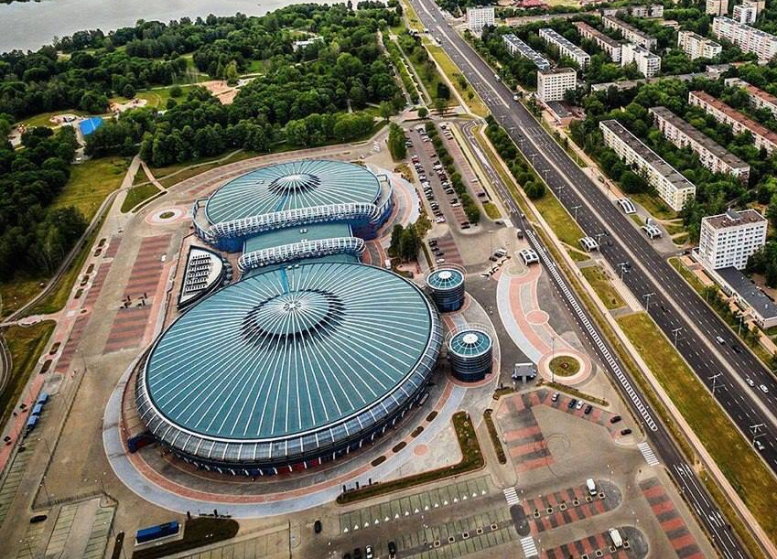
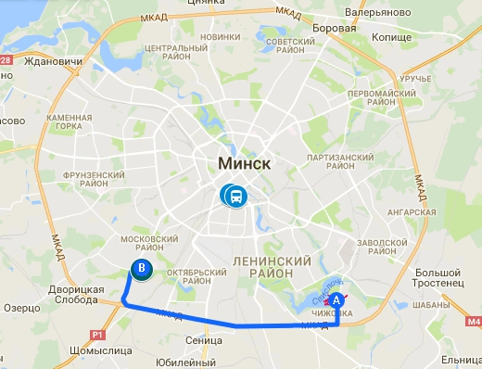
CHIZOVKA Arena
Sports: Judo, Karate
Construction Status: permanent – complete, refurbishment scheduled to be finished
by December 31, 2018
Capacity: 8 800 seats (incl. 43 VIP lounges for 500 seats)
Distance from Athletes Village: 14,3 km
Travel time: 18-25 minutes

Slide 8
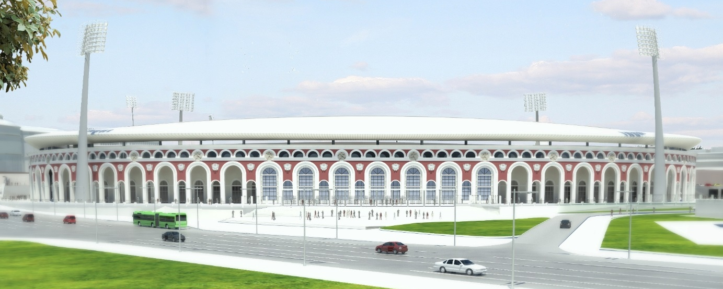
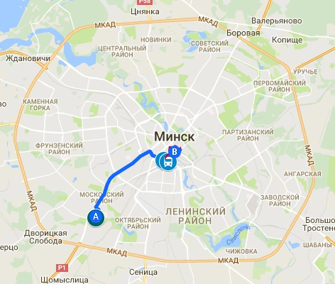
DINAMO Stadium
Opening & Closing Ceremonies
Sport: Athletics
Construction Status: permanent – scheduled to be completed
by June 21, 2018
Capacity: 22 000 seats
Distance from Athletes Village: 9 km
Travel time: 18-25 minutes

Slide 9
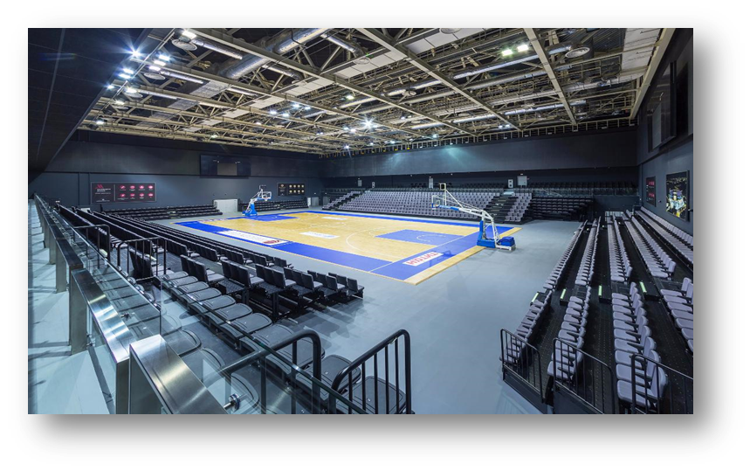
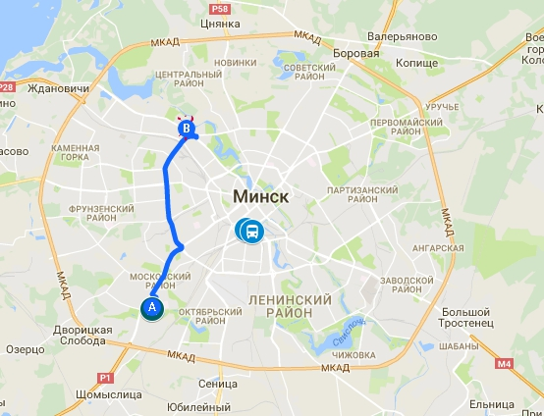
Falcon Club
Sport: Badminton
Construction Status: permanent – complete, refurbishment scheduled to be finished by December 31, 2018
Capacity: 2 000 seats
Distance from Athletes Village: 10,4 km
Travel time: 17-25 minutes

Slide 10
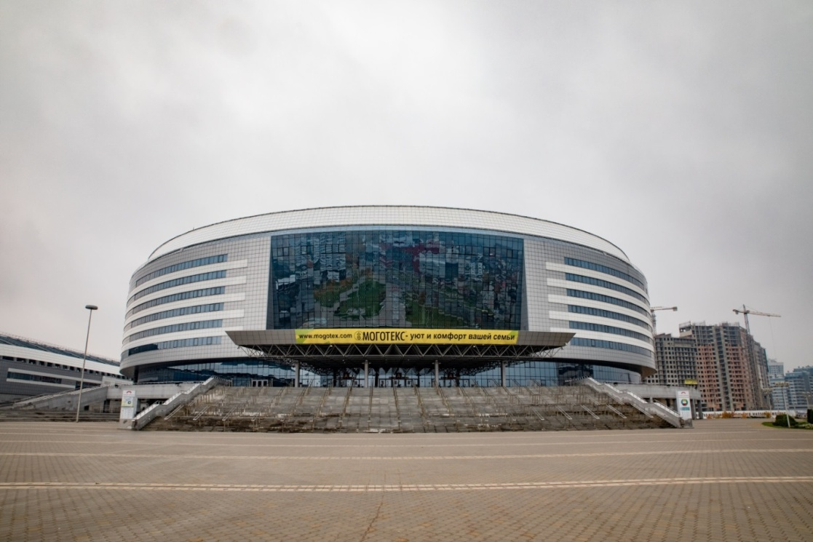
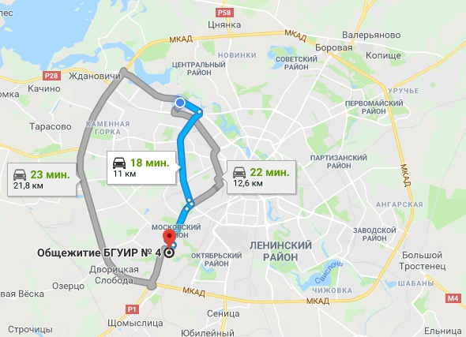
Minsk Arena
Sports: Gymnastics (Acrobatic, Aerobic, Artistic, Rhythmic, Trampoline)
Construction Status: permanent – complete, refurbishment scheduled to be finished
by December 31, 2018
Capacity: 8 000 seats
Distance from Athletes Village: 11,7 / 21,8 km
Travel time: 18-25 / 23-30 minutes

Slide 11
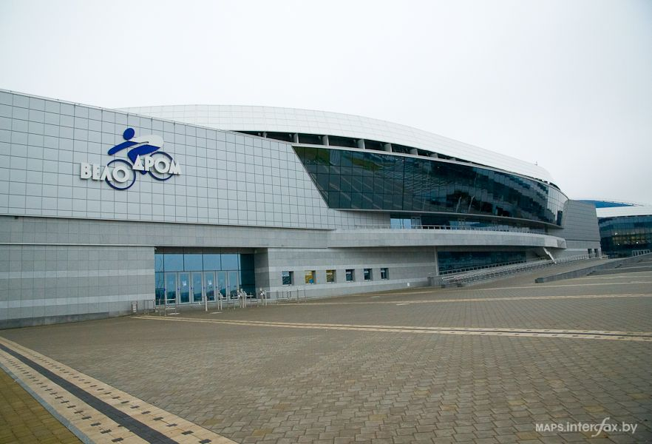

Velodrome (Minsk Arena)
Sport: Cycling Track
Construction Status: permanent – complete, refurbishment scheduled to be finished by December 31, 2018
Capacity: 2 000 seats
Distance from Athletes Village: 11,7 / 21,8 km
Travel time: 18-25 / 23-30 minutes

Slide 12
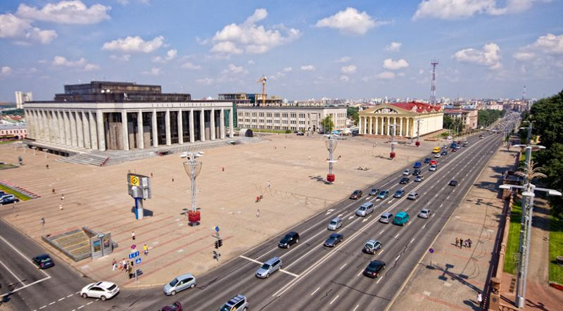
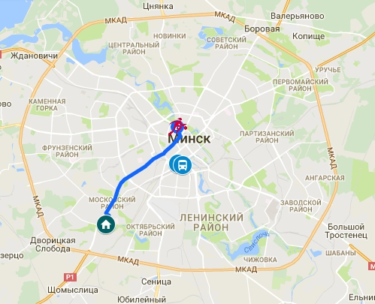
Minsk City Centre (Cycling – Road)
Sport: Cycling – Road
Construction Status: routes are being approved,
overlay planning to start later
Capacity: TBD
Distance from Athletes Village
to Start/Finish point: 9 km
Travel time: 17-25 minutes

Slide 13
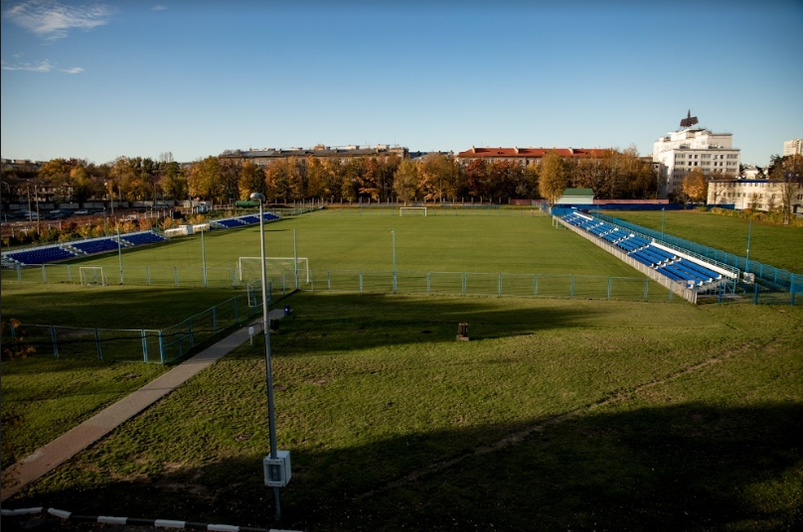
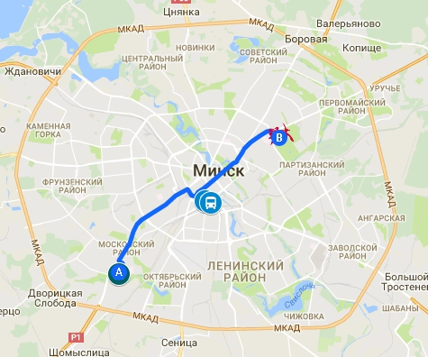
Olympic Sports Complex
Sports: Archery, Beach Soccer
Construction Status: Archery — existing football pitch will be used as the competition venue; Beach Soccer — new pitch with permanent seating will be constructed by June 2018
in the designated area
Capacity: 500 seats (archery); 1 500 seats (beach soccer)
Distance from Athletes Village: 12 km
Travel time: 25-35 minutes

Slide 14
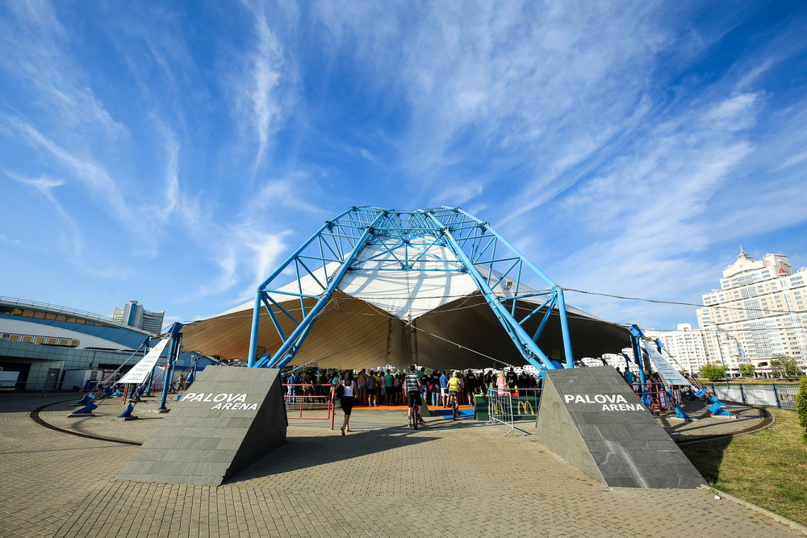
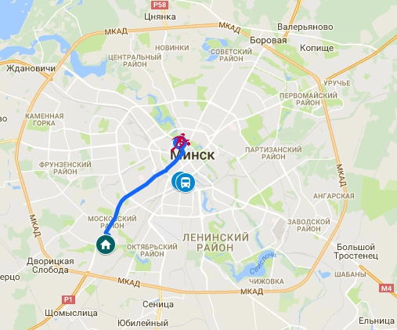
PALOVA Arena
Sport: 3X3 Basketball
Construction Status: permanent – complete, refurbishment scheduled to be finished by December 31, 2018
Capacity: 1 000 seats
Distance from Athletes Village: 9,2 km
Travel time: 25-35 minutes

Slide 15
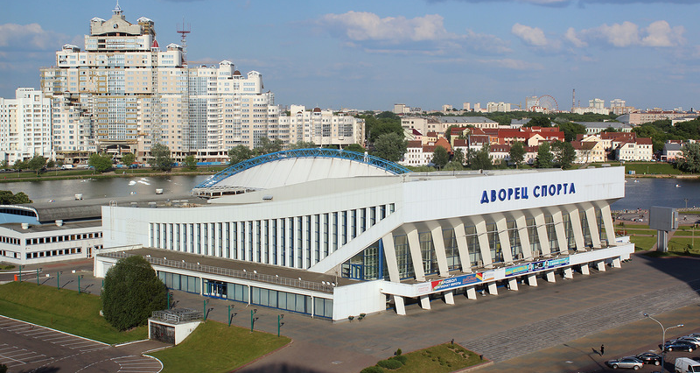
Sports Palace
Sports: Sambo, Wrestling (Greco-Roman, Freestyle, Women)
Construction Status: permanent – complete, renovation and refurbishment scheduled to be finished by December 31, 2018
Capacity: 3 300 seats
Distance from Athletes Village: 9,2 km
Travel time: 25-35 minutes

Slide 16
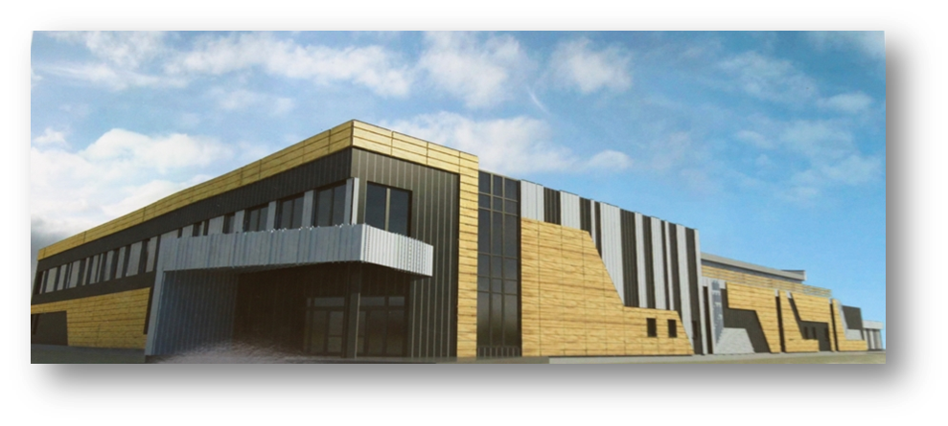
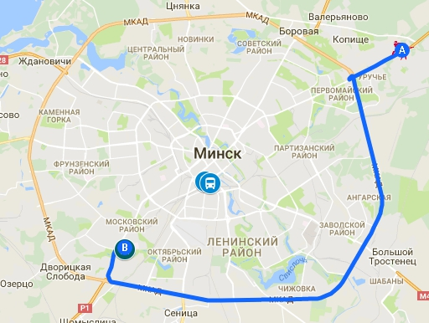
Shooting Centre
Sports: Shooting (Rifle & Pistol)
Construction Status: permanent – under construction, scheduled to be completed in September 2018
Capacity: 250 seats
Distance from Athletes Village: 21,5 / 31 km
Travel time: 30-40 minutes

Slide 17
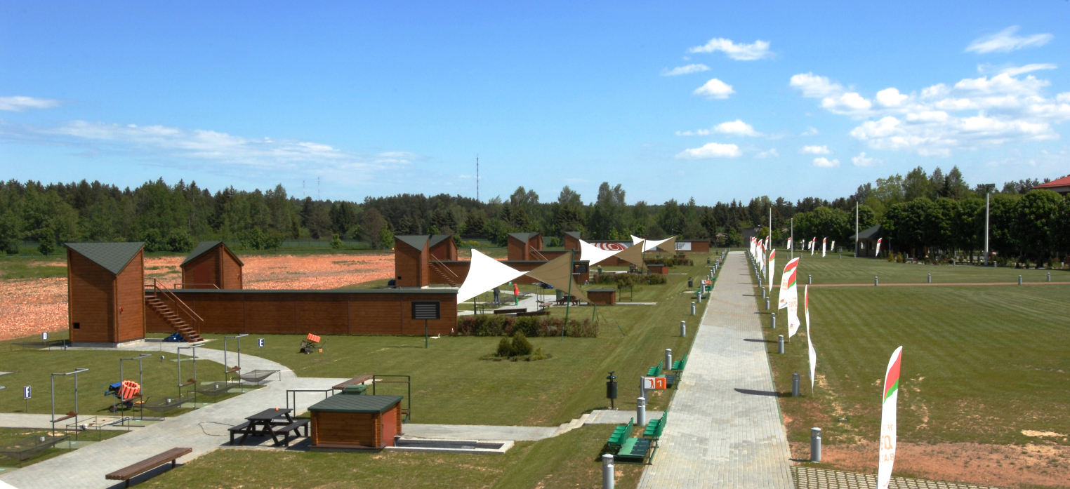
Sporting Club
Sport: Shooting (Shotgun)
Construction Status: permanent – completed, refurbishment scheduled to be finished by December 31, 2018
Capacity: 300 seats
Distance from Athletes Village: 21,5 / 31 km
Travel time: 30-40 minutes

Slide 18
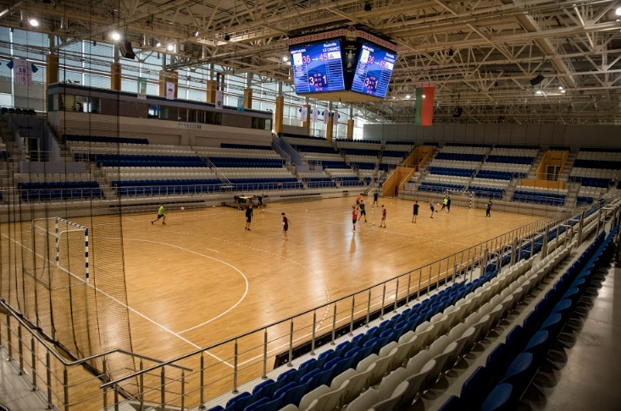
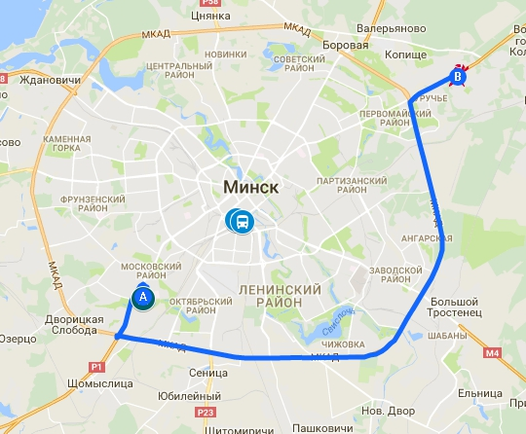
URUCHIE Sports Palace
Sport: Boxing
Construction Status: permanent – complete, refurbishment scheduled to be finished by December 31, 2018
Capacity: 3 000 seats
Distance from Athletes Village: 19,6 / 30 km
Travel time: 28-35 minutes

Slide 19
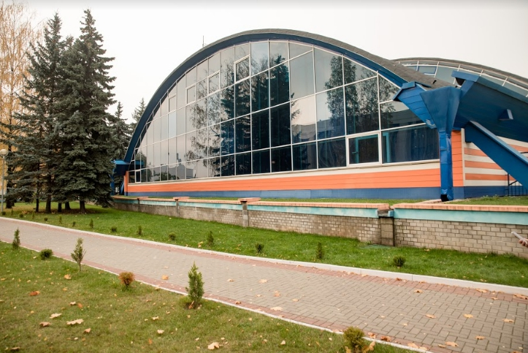
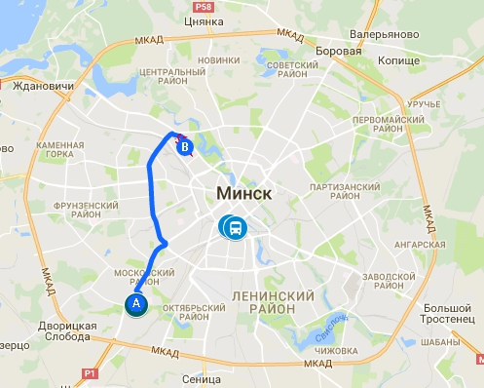
Olympic Tennis Centre
Sport: Table Tennis
Construction Status: permanent – complete, refurbishment scheduled to be finished by December 31, 2018
Capacity: 1000 seats
Distance from Athletes Village: 10 km
Travel time: 17-25 minutes

Slide 20
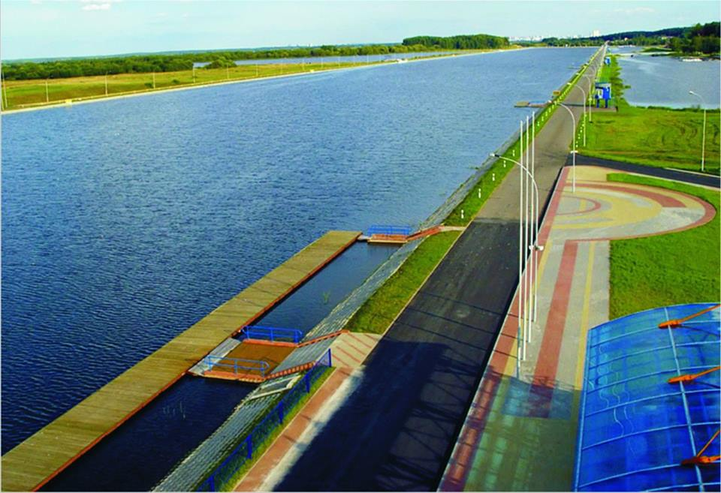
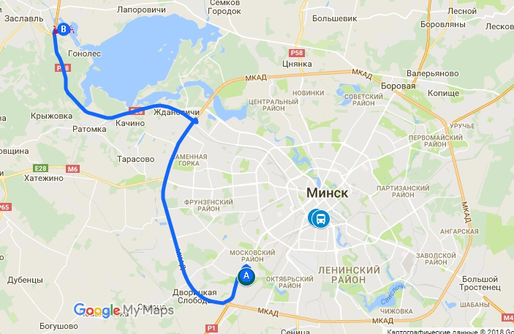
ZASLAVL Regatta Course
Sports: Canoe Sprint
Construction Status: permanent – complete, refurbishment scheduled to be finished by December 31, 2018
Capacity: 1 500 seats
Distance from Athletes Village: 30,4 km
Travel time: 27-37 minutes

Slide 21



